Slide 1
Urinary System
Is composed of :
A. Kidney- paired organs that form the urine.
B. Ureters- carry urine to bladder, one from each kidney.
C. Bladder- site where urine is collected and stored until urination.
D. Urethra. Carries urine from bladder to external environment.

Slide 2
Kidney
_Is bean shaped organ covered by dense irregular
collage nous connective tissue capsule.
_Has a convex border&a medial concave border
have hilum, where the arteries enter, ureter& veins
leave the kidney.
_The upper part of ureter is expanded to form
renal pelvis that branches to several large cup- shaped structure about (2-3) in number (major calyces), and smaller calyces (8-10) (minor calyces).

Slide 3
Each kidney is divided in to :
_Outer cortex
_Inner medulla :which is composed of 10-12 renal
pyramids, the base of pyramid is toward the cortex as (medullar rays).
_Functions of kidney :
1-Regulattion of blood ionic composition, regulate of blood ph, regulation of blood volume, regulation of blood pressure.
2-Maintenance of blood osmolarity.
3-Production of hormones erythropoietin.
4-Excretion of waste products.

Slide 4
Uriniferous tubules
Is composed of :
1- Nephron
2-Collecting tubules and duct
_Nephron
Basic structural and functional unit of kidney, about (30-40 mm) long, (1-4) million in each kidney, has six morphologically distinct segments:
_Glomerulus (Renal corpuscles).
_Convoluted portion, straight portion of proximal tubules.
_Convoluted portion, straight portion of distal tubules.
_Thin &Thick segments (Henles loop).

Slide 5
Note-the proximal and distal convoluted tubules are located in the cortex, the straight portion of proximal and distal tubules &the thick, thin segments make a loop that extend in to the medulla called loop of henles.
_Renal corpuscle :composed of:
A-Glomerulus- a network of blood capillaries (fenestrated) about (10-20) capillaries loop surrounded by Bowman's capsule.
B-Bowmans capsule-enclosed the glomerulus. It has two layers:
*Parietal layer formed by simple squamous epithelium.
*Visceral layer the podocytes.

Slide 6
_Podocytes
*Are modified cells with multiple processes and pedicles.
*Their processes and pedicles surround the glomerular capillaries.
*The spaces between adjacent pedicles, called the filtration
slits.
*The pedicels interdigitate with each other and attach to the basal lamina of capillary endothelium.
_Function of podocytes:
-Mechanical support; they act to prevent the rupture of the glomerular capillaries due to blood pressure and at the same time allow filtration to proceed.
-The secondary processes support the hydrostatic pressure exerted on the basement membrane filtration.

Slide 7
-The epithelium covering each capillary is the glomerula epithelium and that lining the opposing wall is known as capsular epithelium.
-Bowman's space is the space between capillaries and capsular.
-Vascular pole represent the region of the renal corpuscle where the efferent and afferent arterioles are located for composed of glomerulues.
-Urinary pole opposite the vascular pole located where the capsular epithelium is continues with the cub dial epithelium of the proximal convoluted tubule.
-The glomerular capillaries are situated between two arterioles (afferent &efferent) , however,

Slide 8
blood through the capillaries it is under considerable pressure, and a clear fluid, the blood ultra filtrate, filter through the glomerular vessels walls and the glomerular epithelium in to capsular space, urine is formed from the blood ultra filtrate as flow through the various nephron segments.
-Capsular epithelium is typical simple squamous epithelium, it become cuboidal at the urinary pole.

Slide 9
_Proximal tubules
Has two segments :
1-Convoluted part, which makes several loops in the cortex near the renal corpuscles.
2-Straight portion, extending in to the outer zone of the medulla.
_Histological features:
-are lined by high cuboidal epithelium cells that have rounded nucleus centrally located.
-The apical surface there is microvilli (brush border) required for reabsorption.
-more acidophilic than those other parts of nephron, the cytoplasm appears striated due to elongated mitochondria.

Slide 10
-The lateral surface of cells contains folds 9 they are flattened processes, joined with processes of adjacent cells. these epithelial cells are adapted for fluid and ion exchange.
_Distal convoluted tubules:
-The last part of nephron, are found in cortex.
-They are lined by low cuboidal epithelial cells.
-There is no brush border, but occasionally one long cilium project in to the lumen.
-Have large lumen because the epithelium is lower and the cells narrow there are more nuclei than in cross section of proximal segment.
-Less acidophilic than p.c.t, the cells are adapted for fluid and ion exchange

Slide 11
_Loops of henle
U shaped structure, composed of thin and thick segments:
_Thin segment : consist of descending and ascending limb of henles loop, is lined by simple squamous epithelium about (3-50) cells are seen, they resemble the capillary except, their nuclei protrude more in to the lumen, the surface of cells has a few short microvilli.
_Thick segment : consist of ascending limb of H. l, is lined by simple cuboidal epithelium, the cytoplasm is faintly stained, they similar to distal convoluted tubules, the loops maintain the osmotic gradient in renal parenchyma.

Slide 12
Kidney - Internal Gross Anatomy
Know these terms for lecture and lab exams!

Slide 13
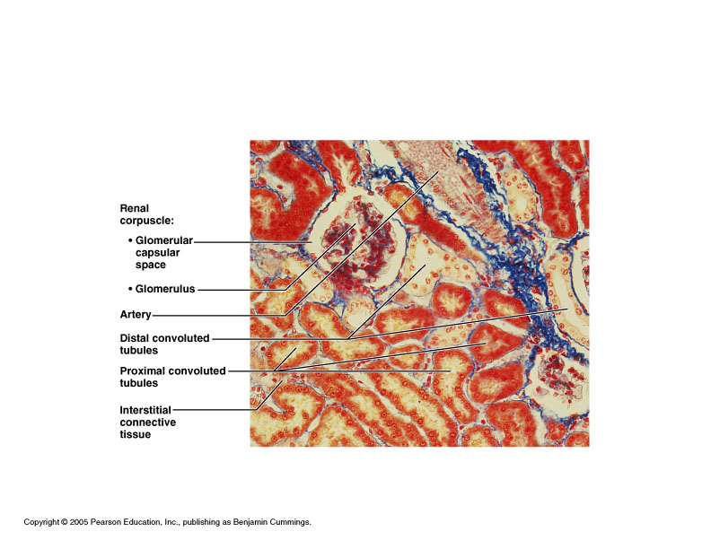
Histology

Slide 14
Kidney - Internal Micro Anatomy
~A million nephrons are located in the cortex
The filtrate is carried by the collecting duct system through the medulla
The urine is collected at the papillae into the minor and major calyxes
Nephron
Papilla
Minor Calyx

Slide 15
Nephron
2 major parts to the nephron
Renal Corpuscle
Renal Tubule

Slide 16
